Slide 1
E-COMMERCE RETAIL DATA ANALYSIS
SQL PROJECT

Slide 2
AGENDA
INTRODUCTION
PROJECT OBJECTIVE
Data Availability
DATABASE TABLES
DATABASE SCHEMA
PRIMARY KEY, FOREIGN KEY
OBJECTIVE QUERY
Performance Insights
Key Recommendations

Slide 3
Introduction
The goal of this project is to analyze data from an online retailer to find insightful information that can guide strategic decision-making. Through the analysis of crucial domains like consumer behavior, transaction patterns, and product efficacy, our objective is to furnish practical suggestions that augment customer involvement, maximize revenue, and elevate overall operational effectiveness.

Slide 4
Project Objective
This initiative aims to improve business performance and customer experience by deriving useful insights from retail e-commerce data. Our goal is to create customized marketing tactics and incentives by analyzing consumer loyalty and retention. In addition, trends, patterns, consumer behavior, sales growth, profitability, and transactional dynamics will all be identified by this analysis. The newfound understanding will facilitate well-informed decision-making for future expansion and offer practical suggestions.

Slide 5
Data Availability
The data set we will be using for this exercise comprises of 3 tables
Customer: Customer demographics
Transactions: Customer transaction details
Product category: Product category and sub category information

Slide 6
DATABASE SCHEMA
Customer Table
The Customer Table contains the information about customers in the E- Commerce Retail Dataset. It includes variables such as customer id, DOB, Gender and city code. The schema of the dataset is 4 variables and 5647 records
Transaction Table
The Transaction Table contains the information about all transactions occur in the E- Commerce Retail Dataset. It includes variables such as transaction id, customer id, transaction id, prod sub cat code, prod cat code, quantity, rate, tax, total amount and store type. The schema of the dataset is 10 variable and 23053 records.
Product Table
The Product Table contains the information about the product availability in the E- Commerce Retail Dataset. It includes variables such as prod cat code, prod cat, prod sub cat code and prod sub cat. The schema of the dataset is 4 variables and 23 records.

Slide 7
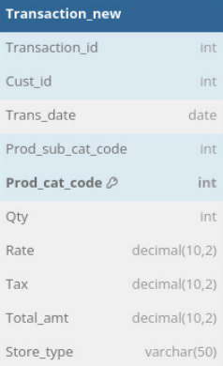
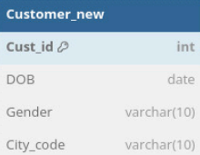
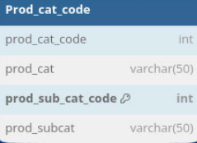
DATABASE SCHEMA

Slide 8
PRIMARY KEY
A primary key is a unique identifier for each record in a database table
EXAMPLE:
CUSTOMER_NEW - CUST_ID
PROD_CAT_CODE PROD_SUB_CAT_CODE
TRANSACTION_NEW-PROD_CAT_CODE
FOREIGN KEY
A foreign key is a field (or collection of fields) in one table that refers to the primary key in another table.
EXAMPLE:
Transaction_NEW:
Cust_id (reference to CUSTOMER_NEW)
Prod_sub_cat_code(reference to Prod_cat_code)

Slide 9

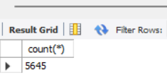
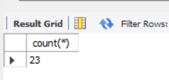

DATA PREPARATION AND UNDERSTANDING
1. What is the total number of rows in each of the 3 tables in the database?
Query :-
prod)_cat_info
customers_new
prod)_cat_info
transaction_new

Slide 10


2. What is the total number of transactions that have a return?

Slide 11
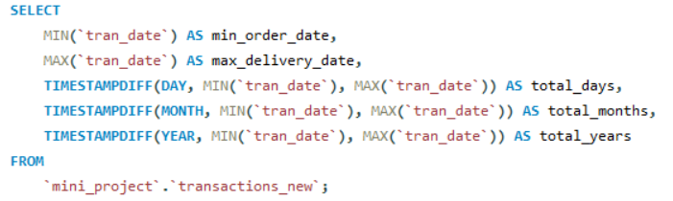

3. What is the time range of the transaction data available for analysis? Show the output in number of days, months and years simultaneously in different columns.

Slide 12


4. Which product category does the sub-category "DIY" belong to?

Slide 13
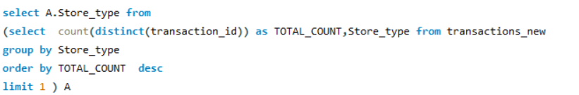

DATA ANALYSIS
Which channel is most frequently used for transactions?

Slide 14

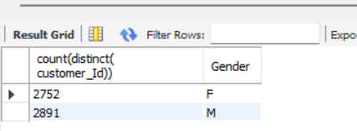
2. What is the count of Male and Female customers in the database?

Slide 15
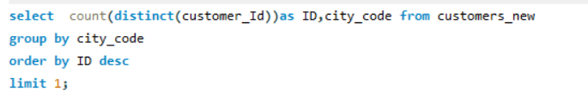

3. From which city do we have the maximum number of customers and how many?

Slide 16

4.How many sub-categories are there under the Books category?

Slide 17
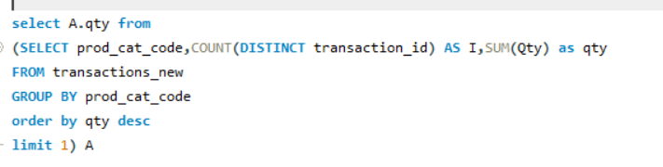
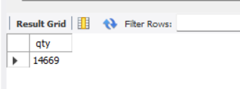
5. What is the maximum quantity of products ever ordered?

Slide 18
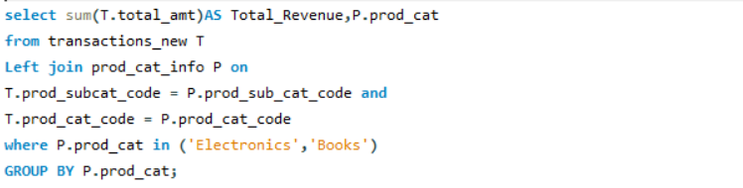
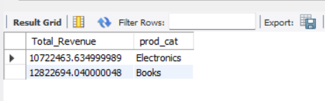
6. What is the net total revenue generated in categories Electronics and Books?

Slide 19
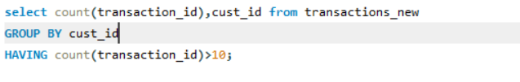
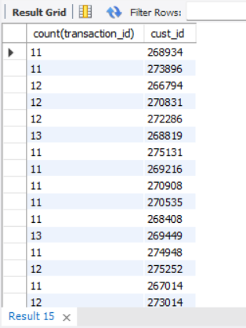
7. How many customers have >10 transactions with us, excluding returns?

Slide 20
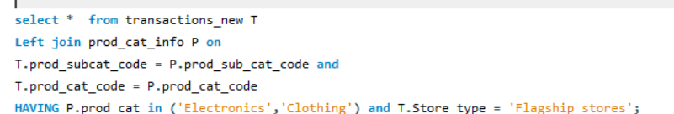
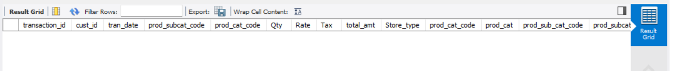
8. What is the combined revenue earned from the "Electronics" & "Clothing" categories, from "Flagship stores"?

Slide 21
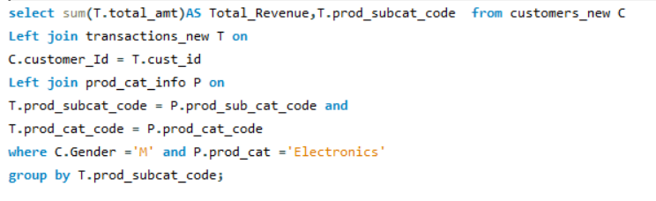
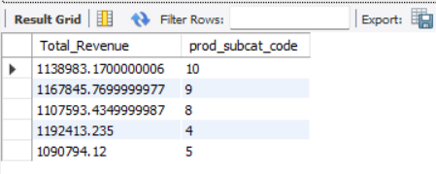
9. What is the total revenue generated from "Male" customers in "Electronics" category? Output should display total revenue by prod sub-cat.

Slide 22
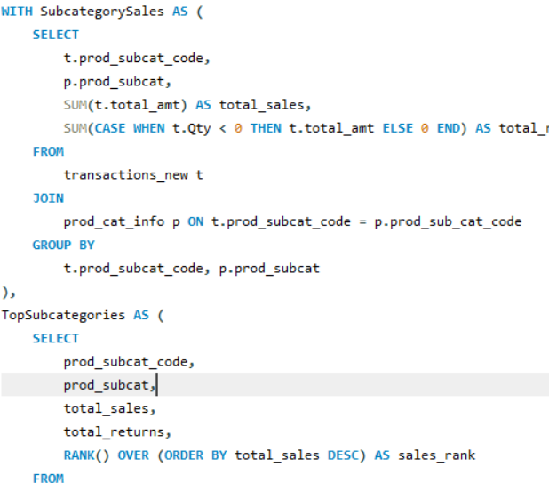
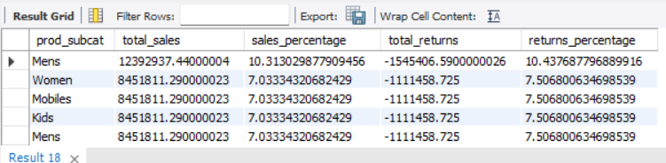
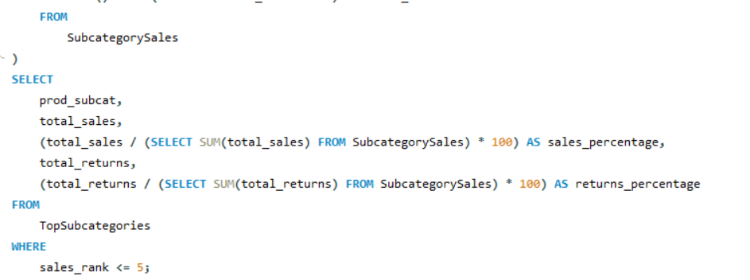
10. What is percentage of sales and returns by product sub category; display only top 5 sub categories in terms of sales?

Slide 23
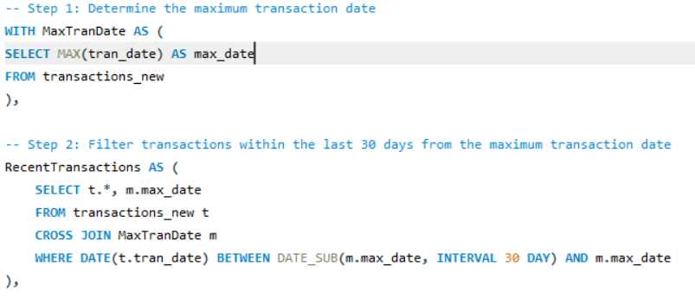
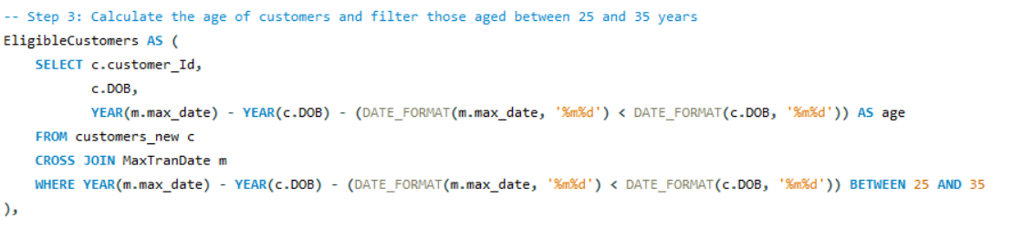
11. For all customers aged between 25 to 35 years find what is the net total revenue generated by these consumers in last 30 days of transactions from max transaction date available in the data?

Slide 24
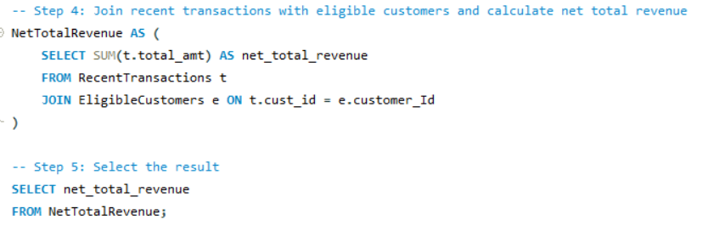


Slide 25
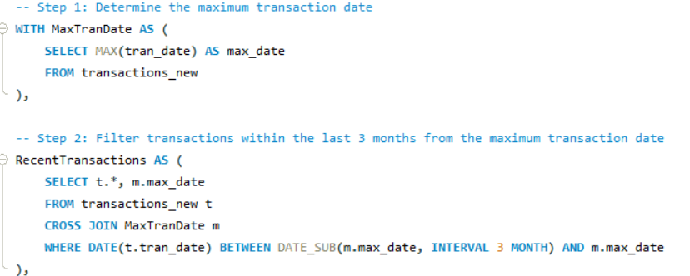
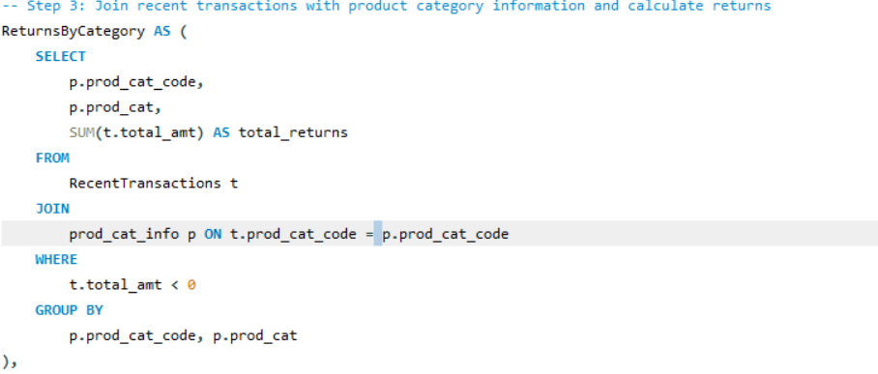
12. Which product category has seen the max value of returns in the last 3 months of transactions?

Slide 26
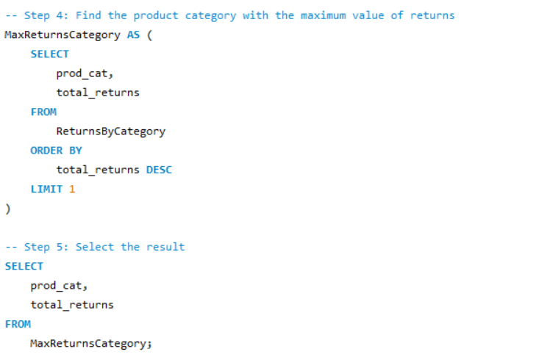


Slide 27
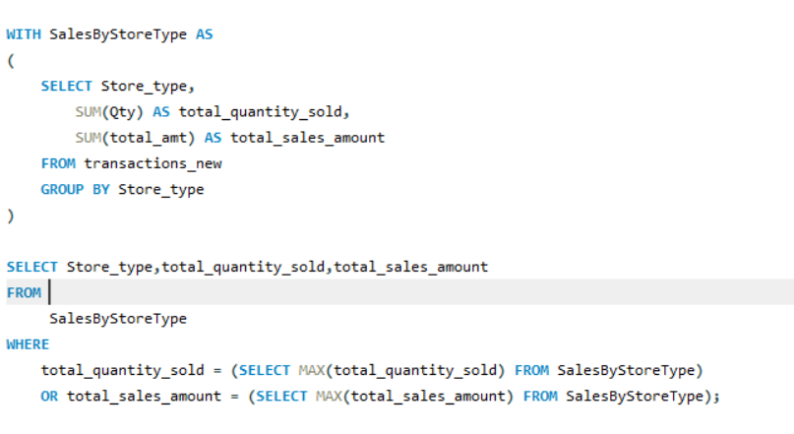
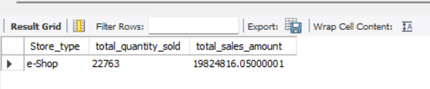
13. Which store-type sells the maximum products; by value of sales amount and by quantity sold?

Slide 28
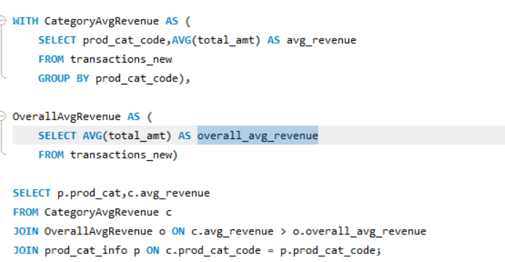
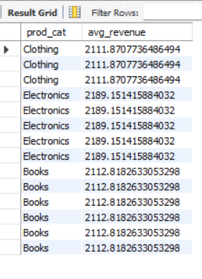
14. What are the categories for which average revenue is above the overall average.

Slide 29
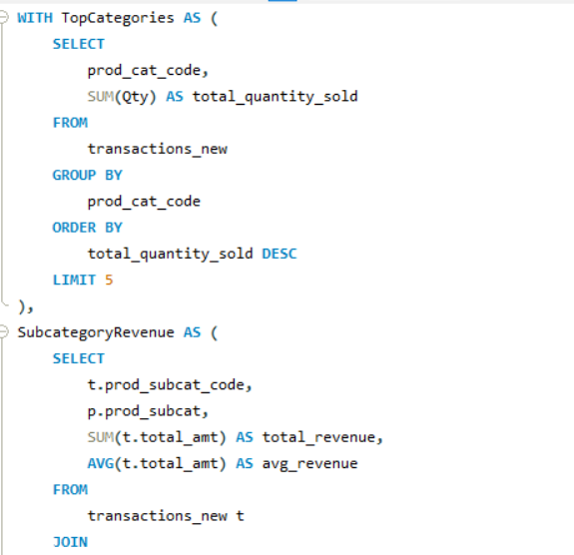
15. Find the average and total revenue by each subcategory for the categories which are among top 5 categories in terms of quantity sold.

Slide 30
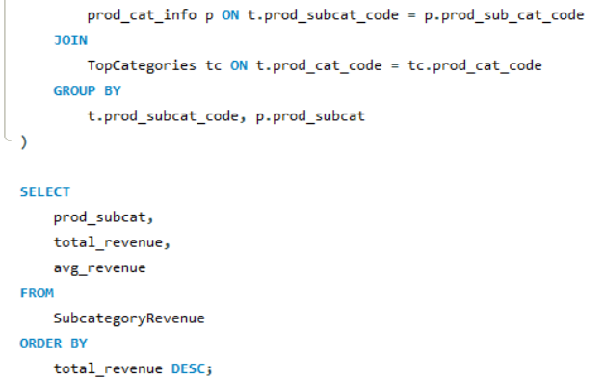
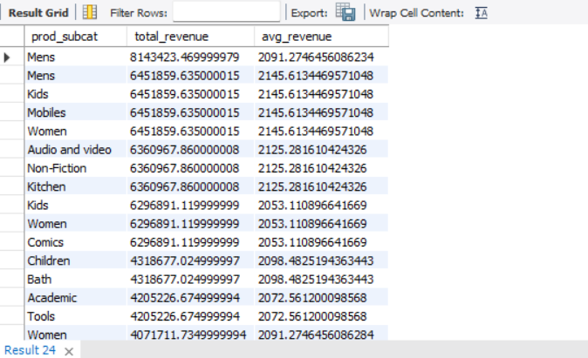

Slide 31
Performance Insights
Summary :-
E-shop is preferred by customers. January 2011–December 2014 is the data period. City Code 3: Maximum number of clients (595). Books, Electronics, Clothes, Kitchen, and Household are the categories. $74,885 in revenue from 30 sales.

Slide 32
Key Recommendations:-
Enhance Online Shopping Experience:
- Upgrade the website and mobile app for improved user experience.
- Ensure quicker and more dependable delivery services.
Focus on High-Performing Categories:
- Broaden the product selection in Books and Electronics.
- Introduce exclusive deals in these categories.
Target City Code 3:
- Implement localized marketing campaigns and special promotions to capitalize on the high customer base.
Optimize Other Categories:
- Evaluate the Clothing and Kitchen/Home categories for enhancements based on customer feedback.

Slide 33
Thank you………
Surya K
Mail :- suryakarolly@gmail.com

